Slide 1
DR.SNSRCAS, CBE
SUBJECT: CLOUD TECHNOLOGY FUNDAMENTALS
COURSE CODE:21UCA501 UNIT - IV
TITLE: Exploring the Google Toolkit
YEAR: III SEMESTER 2022-2023 (ODD)

Slide 2
Exploring the Google Toolkit
Google has an extensive program that supports developers who want to leverage Google’s cloud based applications and services.

Slide 3
Exploring the Google Toolkit
These APIs reach into every corner of Google’s business. Google’s Code Home page for developers may be found at http://cod e.google.com.
you can access developer tools, information on how to use its various APIs to include Google services in your own work, and technical resources.

Slide 4
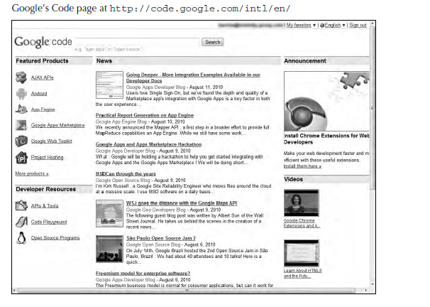
Exploring the Google Toolkit

Slide 5
Exploring the Google Toolkit
Google has a number of areas in which it offers development services, including the following:
1) AJAX APIs
2) Android
3) Google App Engine
4) Google Apps Marketplace
5) Google Gears
6) Google Web Toolkit
7) Project Hosting

Slide 6
Exploring the Google Toolkit
Google has a number of areas in which it offers development services, including the following:
1)AJAXAPIs(http://code.google.com/intl/en/apis/ajax/) are used to build widgets and other applets commonly found in places like iGoogle. AJAX provides access to dynamic information using JavaScript and HTML.

Slide 7
Exploring the Google Toolkit
2) Android (http://developer.android.com/index.html) is a phone operating system development.
3) Google App Engine (http://appengine.google.com/) is Google’s Platform as a Service (PaaS) development and deployment system for cloud computing applications.

Slide 8
Exploring the Google Toolkit
4) Google Apps Marketplace (http://code.google.com/intl/en/googleapps/ marketplace/) offers application development tools and a distribution channel for cloud-based.

Slide 9
Exploring the Google Toolkit
5) Google Gears (http://gears.google.com/) is a service that provides offline access to online data. Google Gears includes a database engine installed on the client that caches data and synchronizes it.

Slide 10
Exploring the Google Toolkit
5) Google Gears Gears allows cloud-based applications to be available to a client even when a network connection to the Internet isn’t available. Using Gears, you could work on your mail in Gmail offline, for example.

Slide 11
Exploring the Google Toolkit
5) Google Web Toolkit (GWT; http://code.google.com/webtoolkit) is a set of development tools for browser-based applications.
GWT is an open-source platform that has been used to create Google Wave and Google AdWords.
GWT allows developers to create AJAX applications using Java or with the
GWT compiler using JavaScript.

Slide 12
Exploring the Google Toolkit
6) Project Hosting (http://code.google.com/intl/en/projecthosting/) is a project management tool for managing source code.

Slide 13
Thank You

